Slide 1
Instruction of EmoTalk3D Dataset
Yicheng Gong

Slide 2
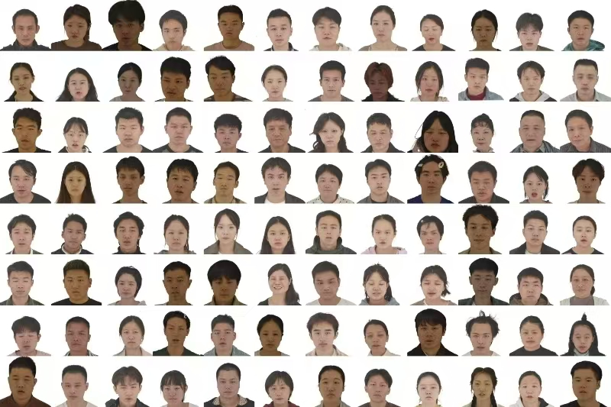
Instruction of EmoTalk3D Dataset
Thumbnails of EmoTalk3D Dataset

Slide 3
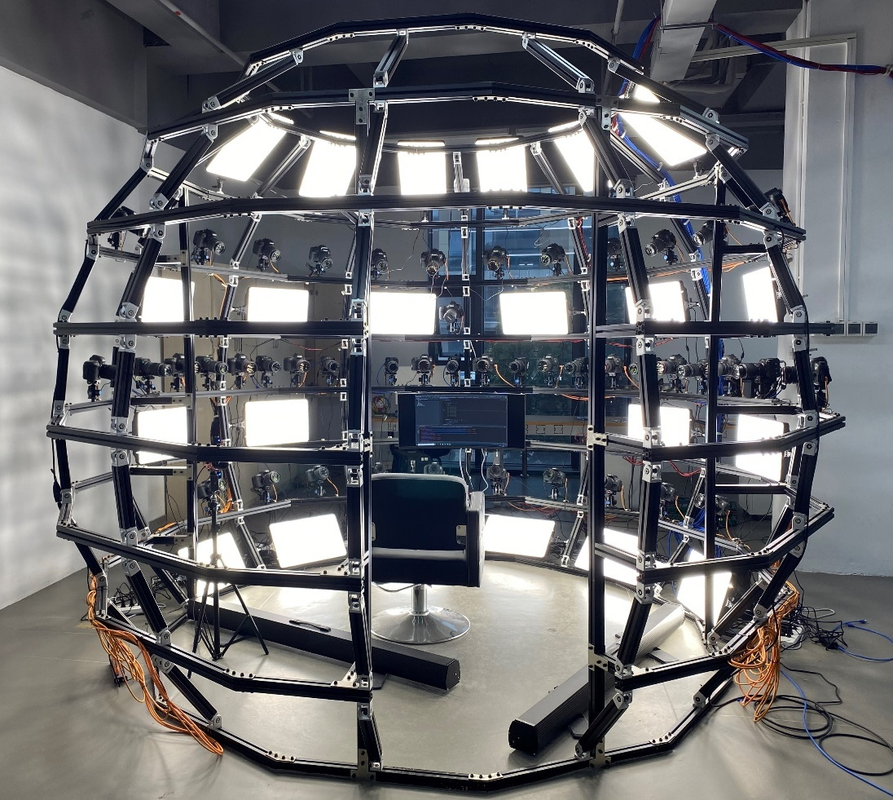
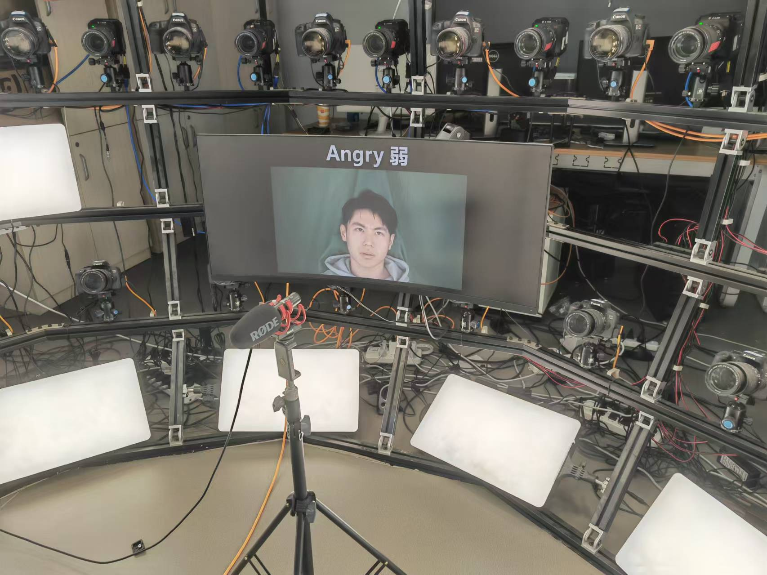
Instruction of EmoTalk3D Dataset
Multi-view Face Capture System
Full-head capture: evenly distributed across a 180°, enabling full-head synchronized video capture
Hi-Res video: 11 Z CAM E2, up to 4K@59.94fps
Hi-Res audio: RODE VideoMic Go II microphone, 320Kbps

Slide 4
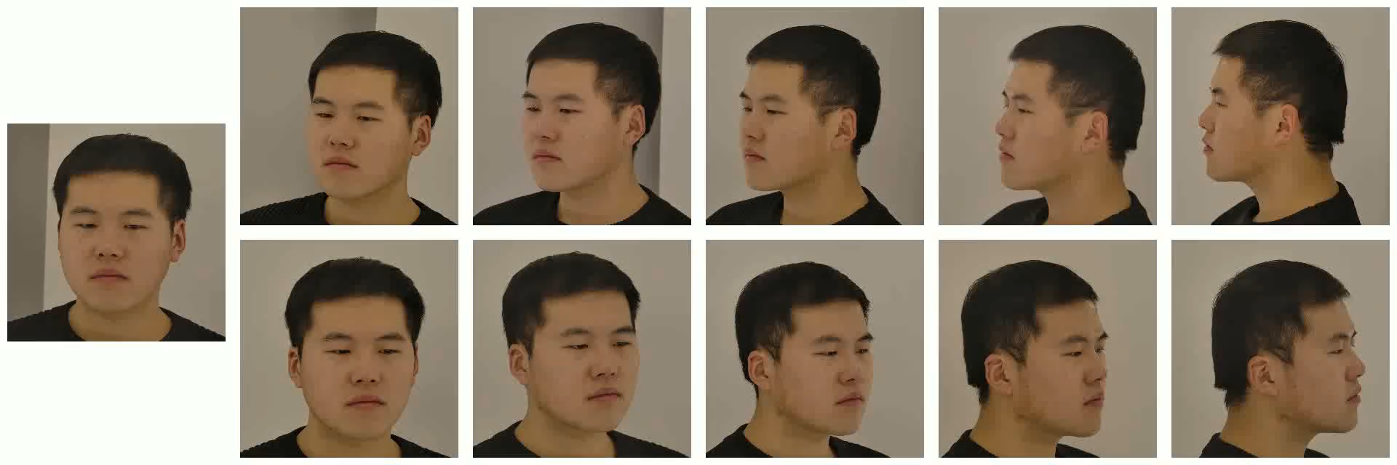
Instruction of EmoTalk3D Dataset
11-view capture

Slide 5
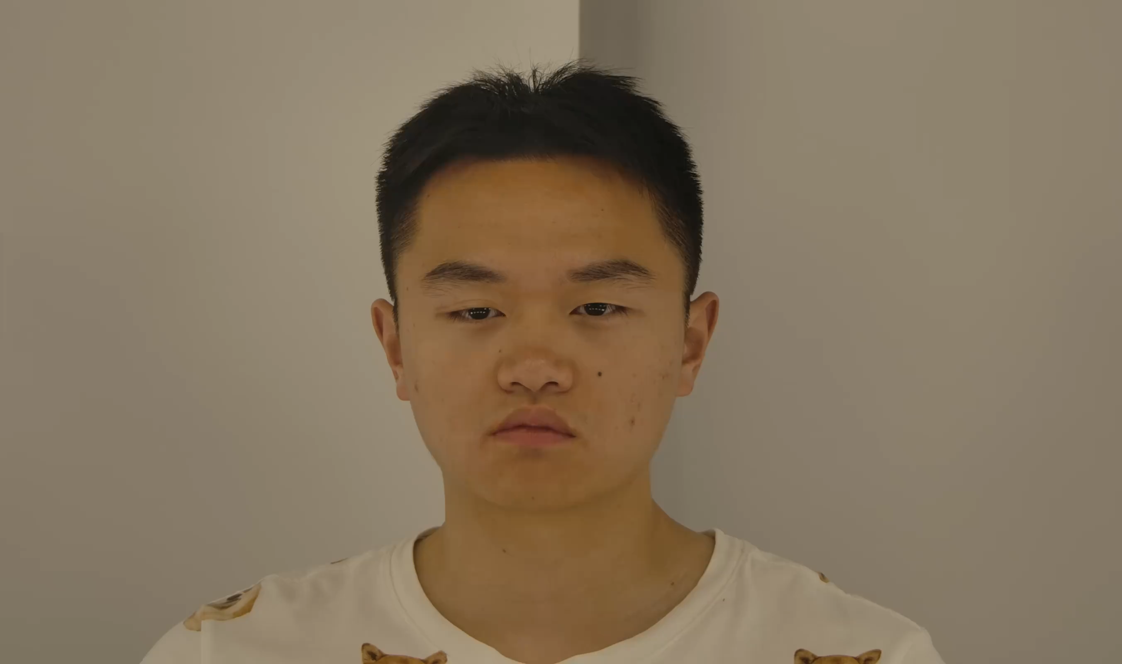
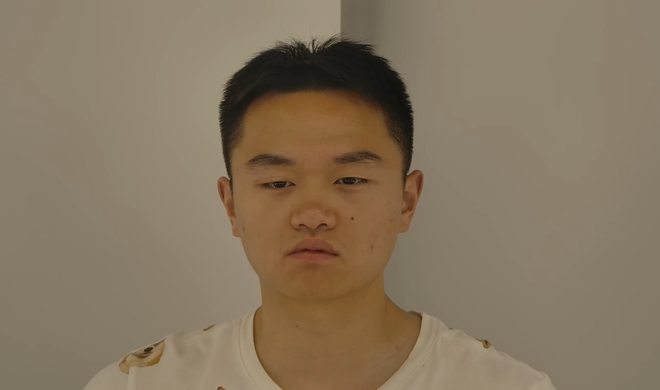
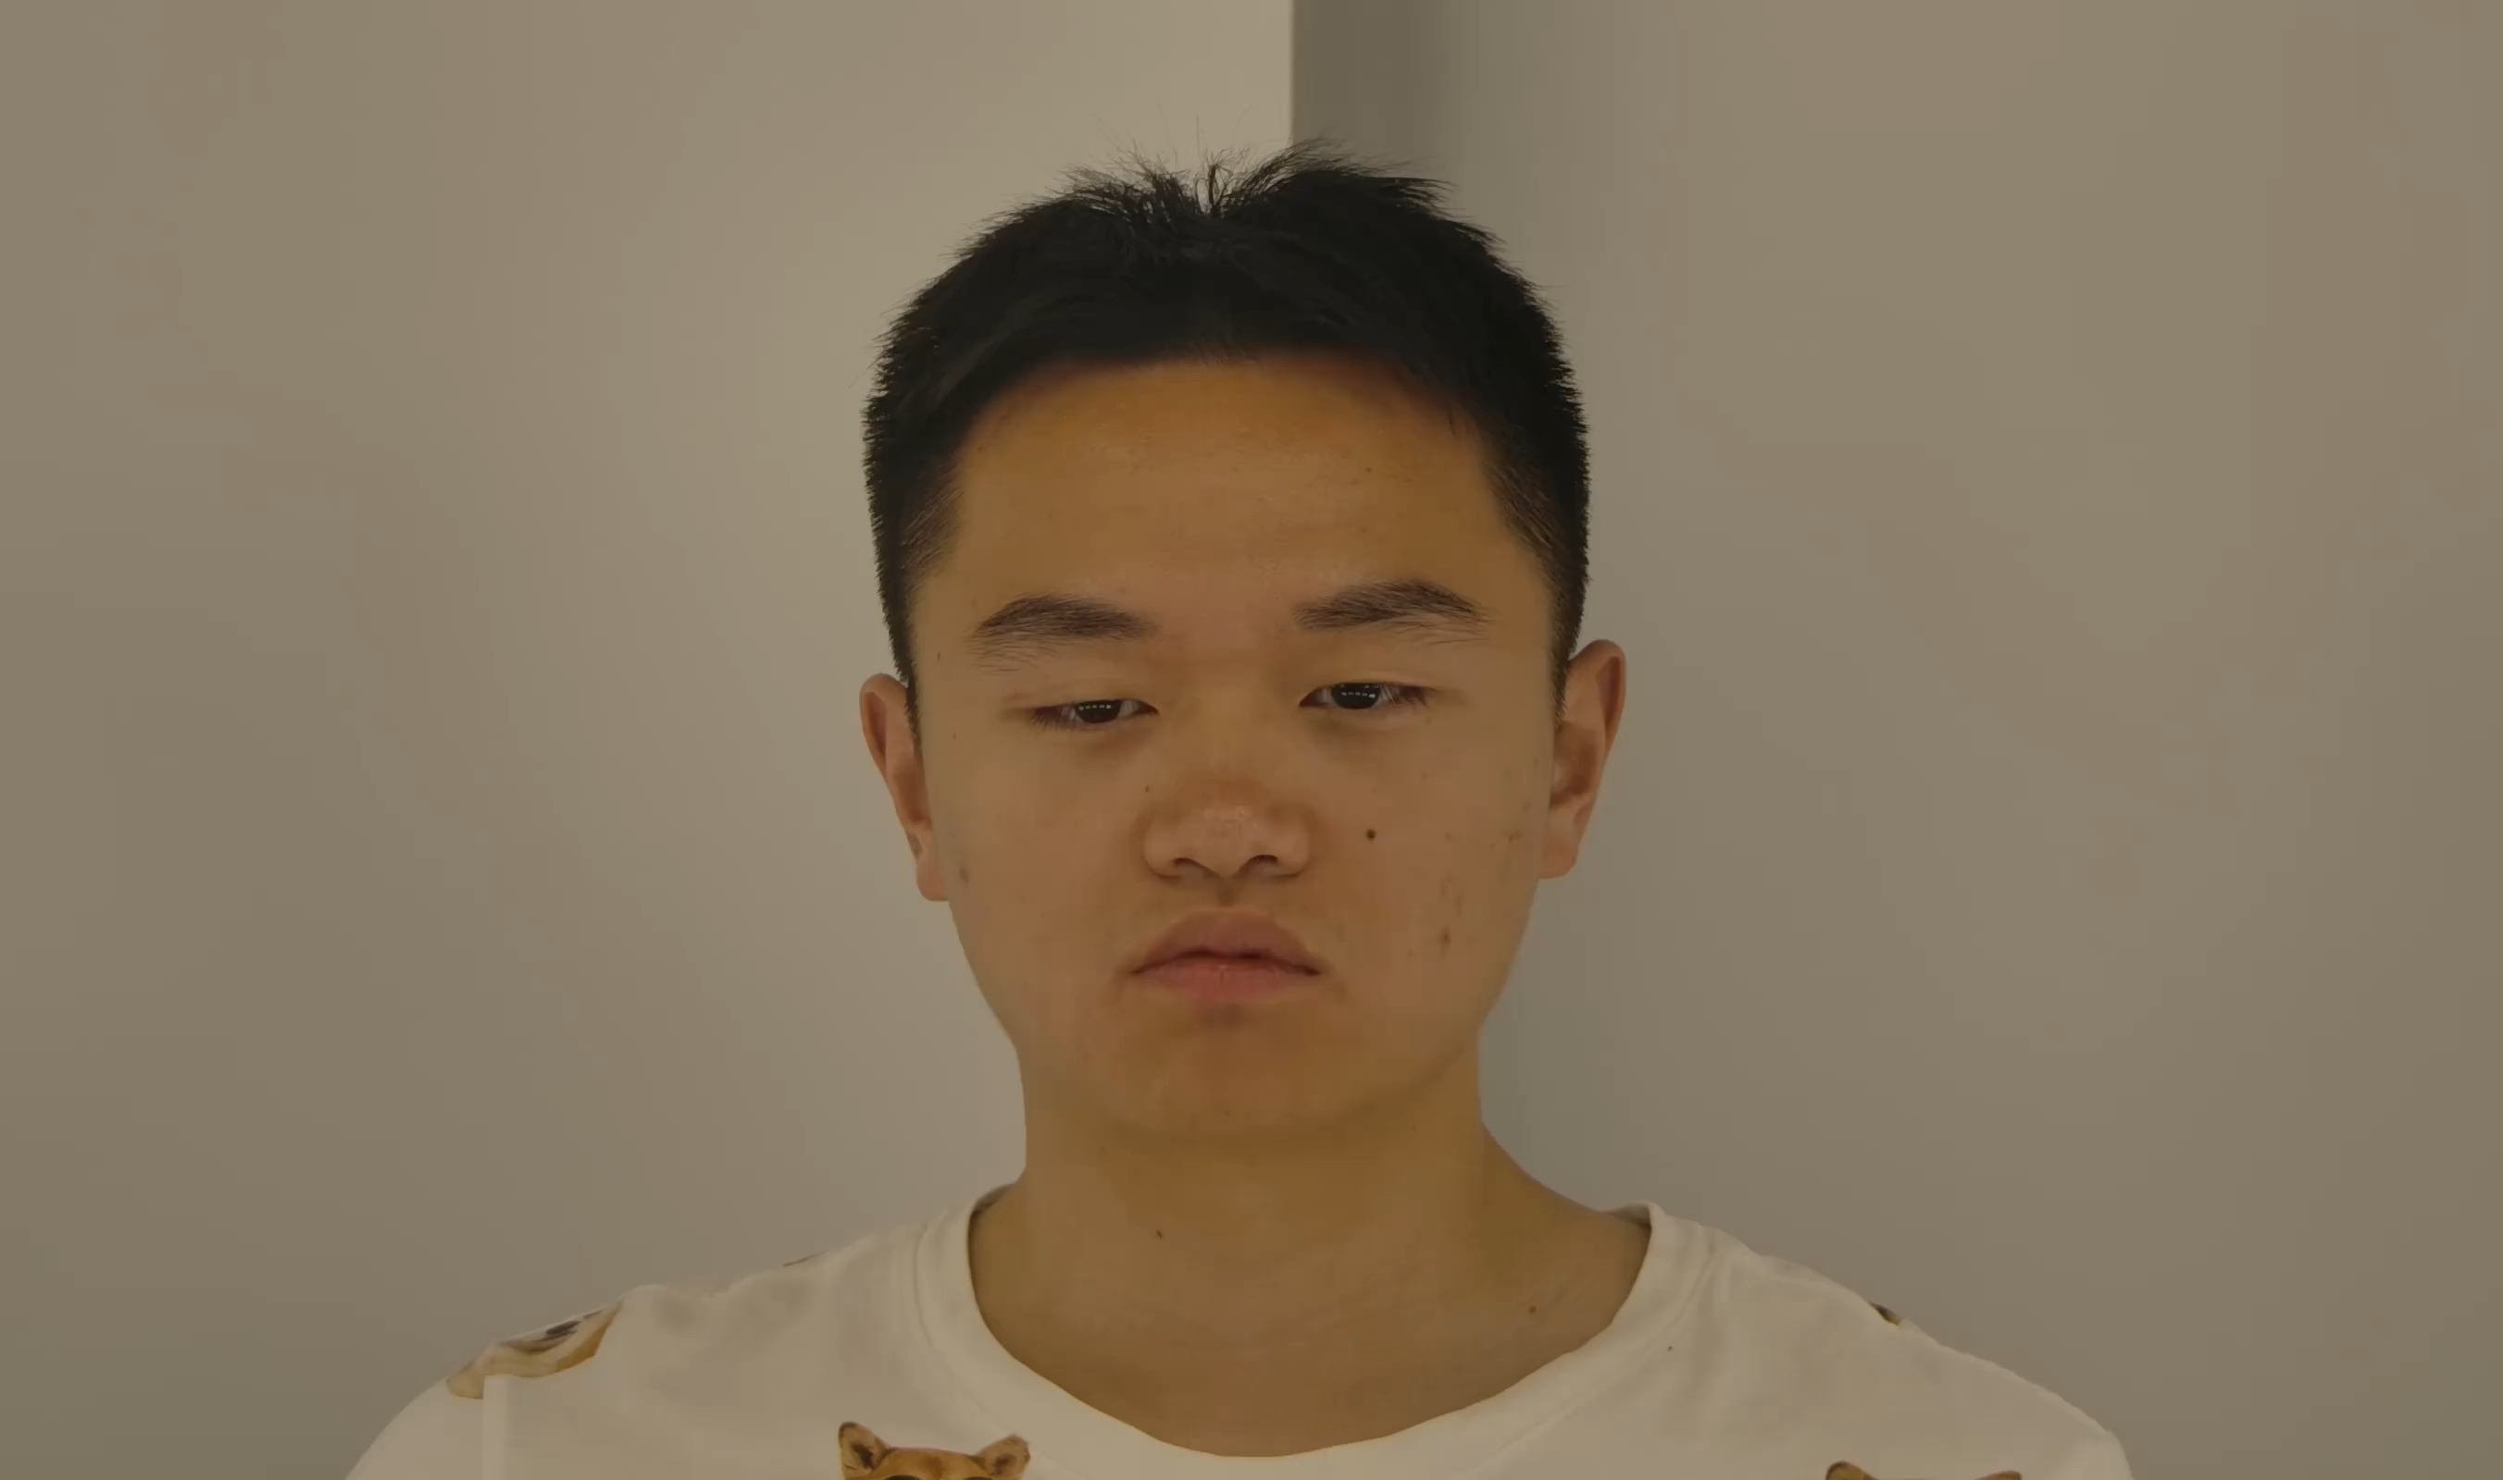
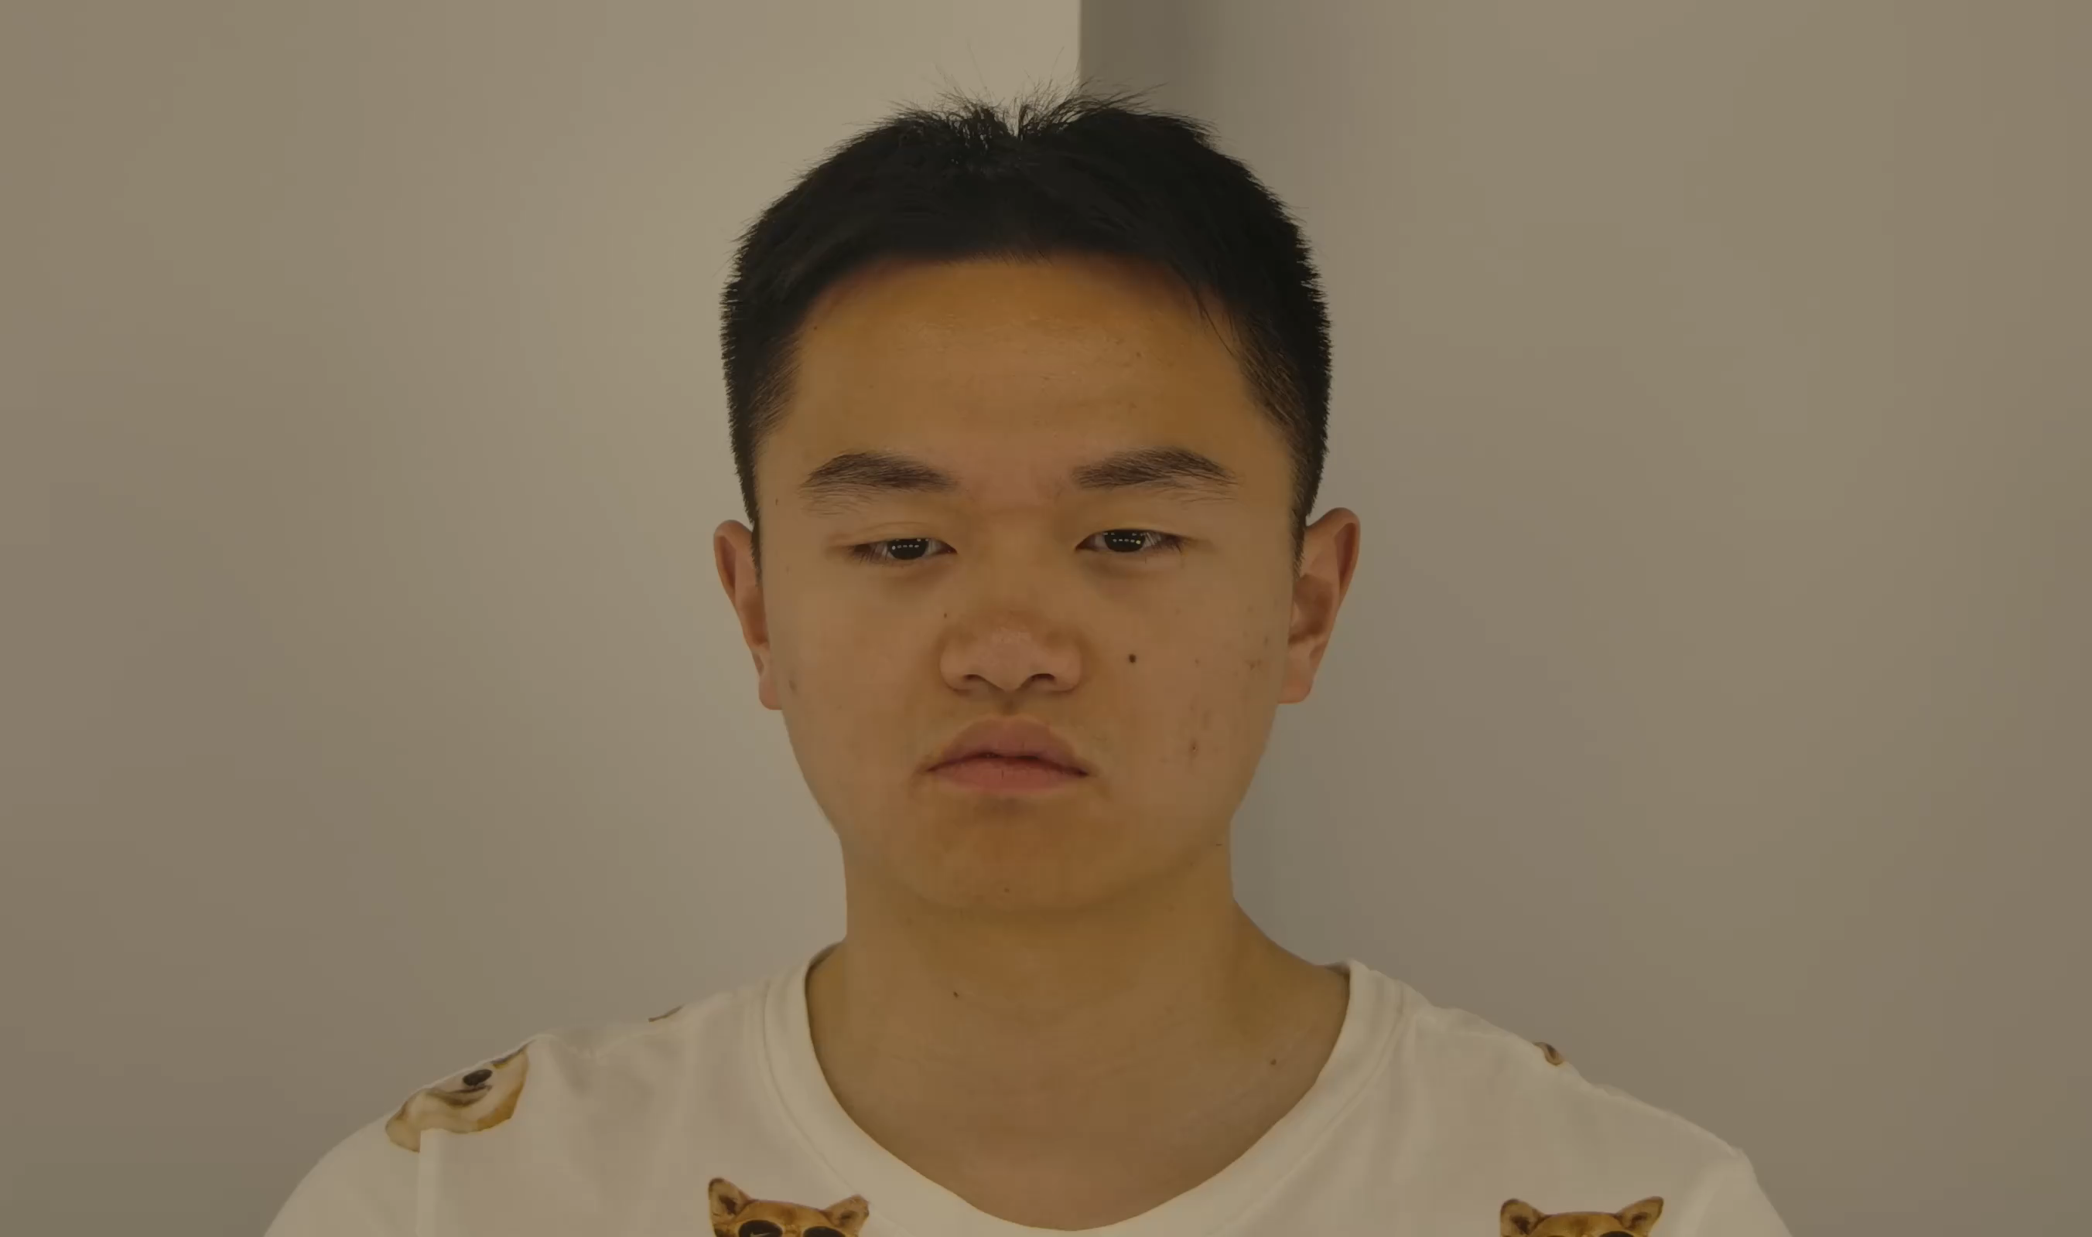
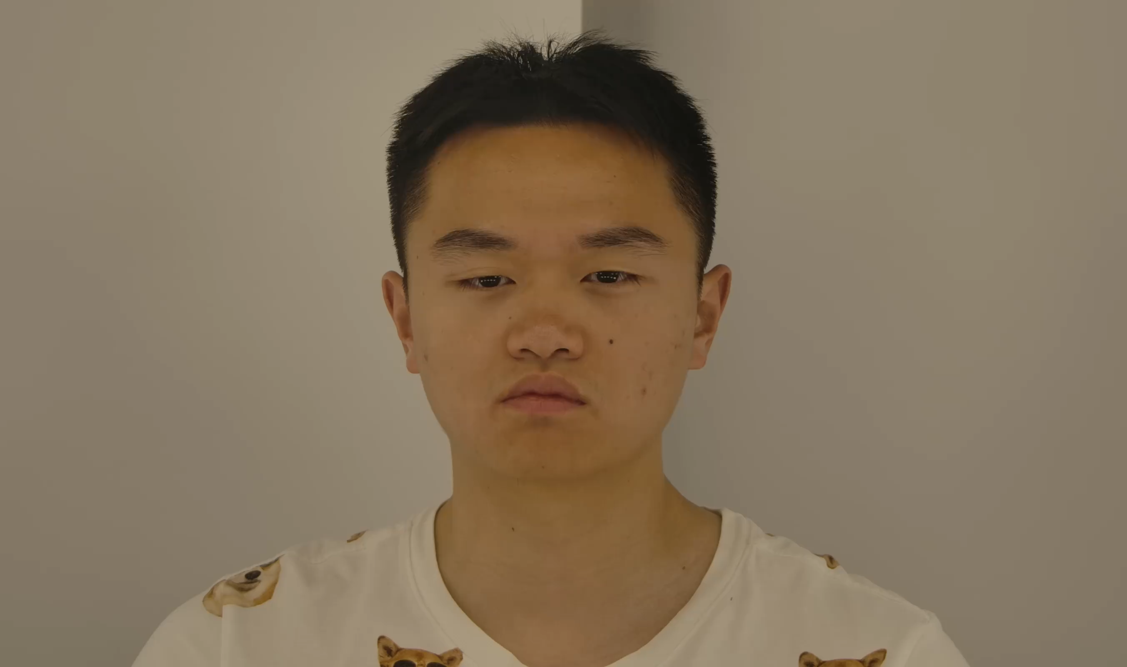
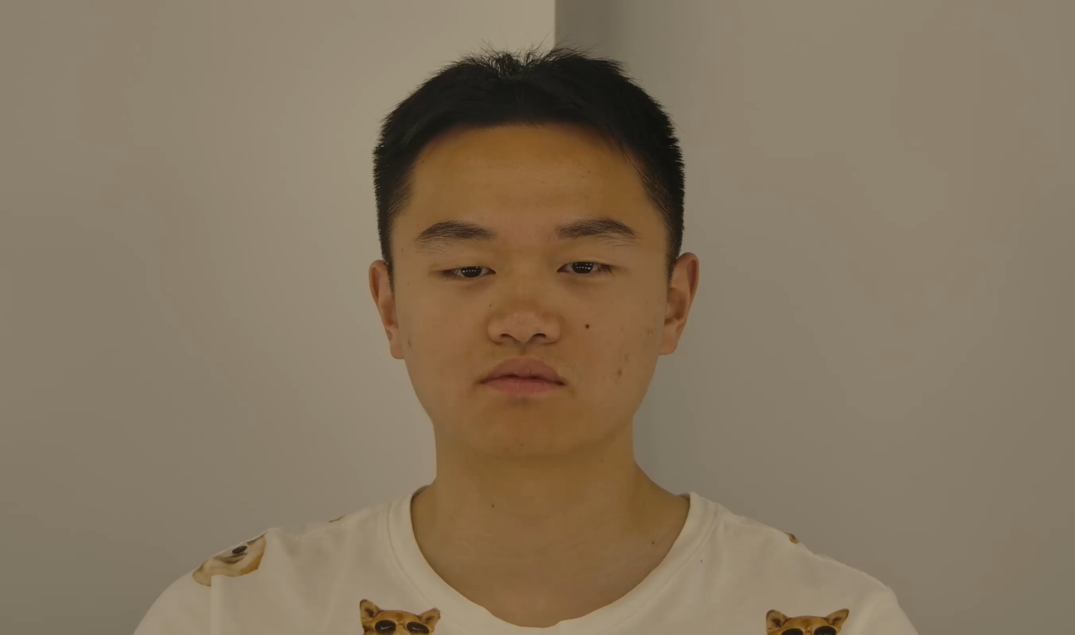
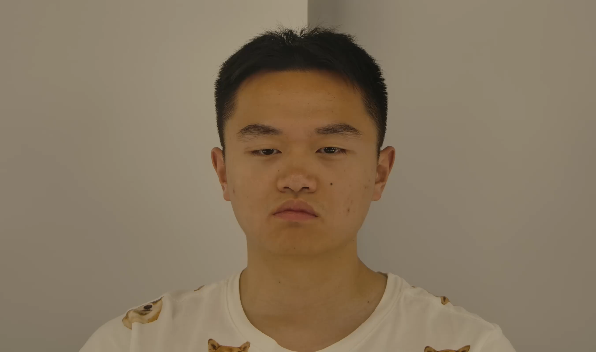

Instruction of EmoTalk3D Dataset
Data Acquisition
Multi emotions: neutral, angry, contempt, disgusted, fear, happy, sad, and surprised.
Each emotion is recorded at both weak and strong intensity levels.
Phase I (30 Participants, 07/2023 ~ 06/2024)
For each emotion, 20 Chinese and 20 English sentences, among which 5 Chinese and 5 English were shared.
Each participant 40 minutes, bilingual video data.
Neutral
Angry
Contempt
Disgusted
Fear
Happy
Sad
Surprised

Slide 6
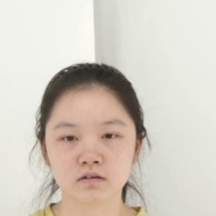
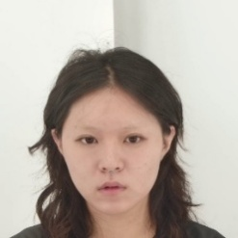
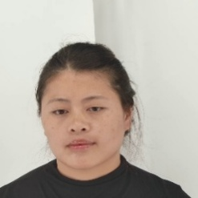
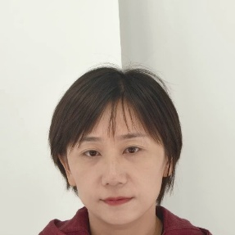
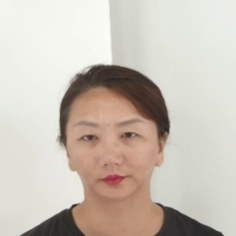
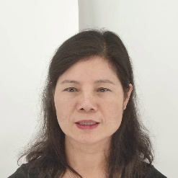

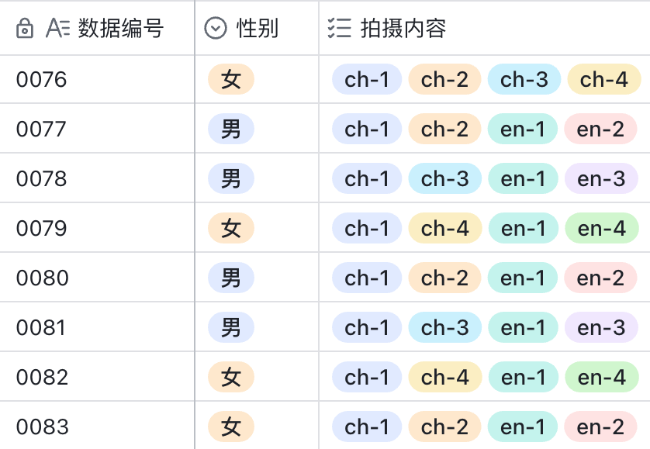
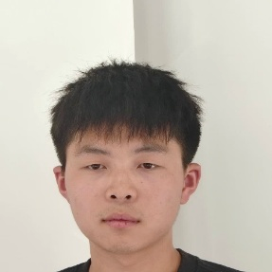

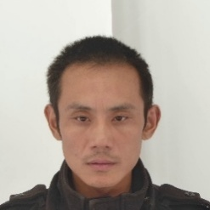
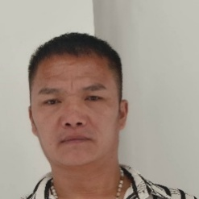
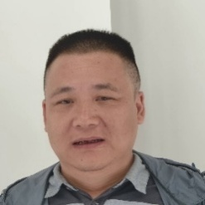

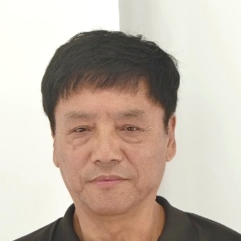
Instruction of EmoTalk3D Dataset
Data Acquisition
Phase II (70 Participants, 08/2024 ~ 12/2024)
For each emotion, 20 sentences (20 Chinese, or 10 English + 10 Chinese) were selected.
5 Chinese and 5 English sentences were shared across all emotions.
Each participant contributed ~20 minutes of bilingual video data.
Gender distribution is more balanced (31 females / 70 total), Age range is more diverse (18 to 70 years old).
Optimized sentence allocation strategy, Reduced length (40min → 20min) while preserving content diversity.
Phase II, Gender & Age Distribution
Content Diversity
Female
Male
18
30
40
50
60
70

Slide 7
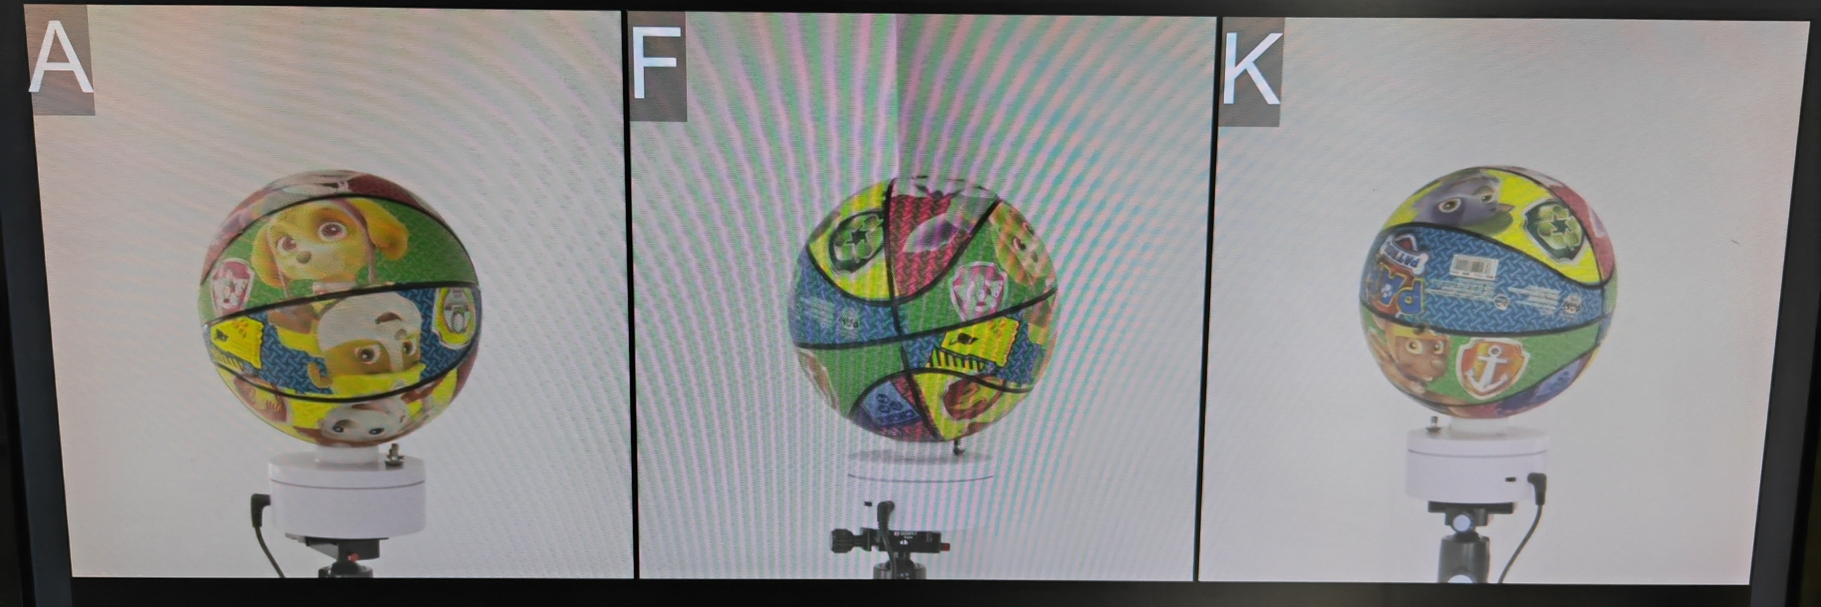
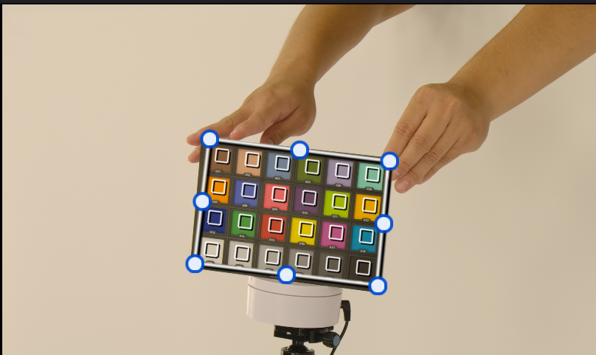
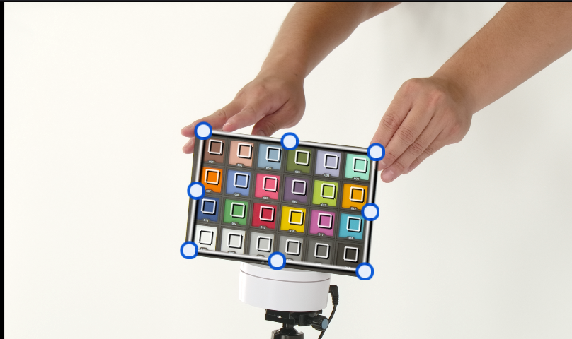
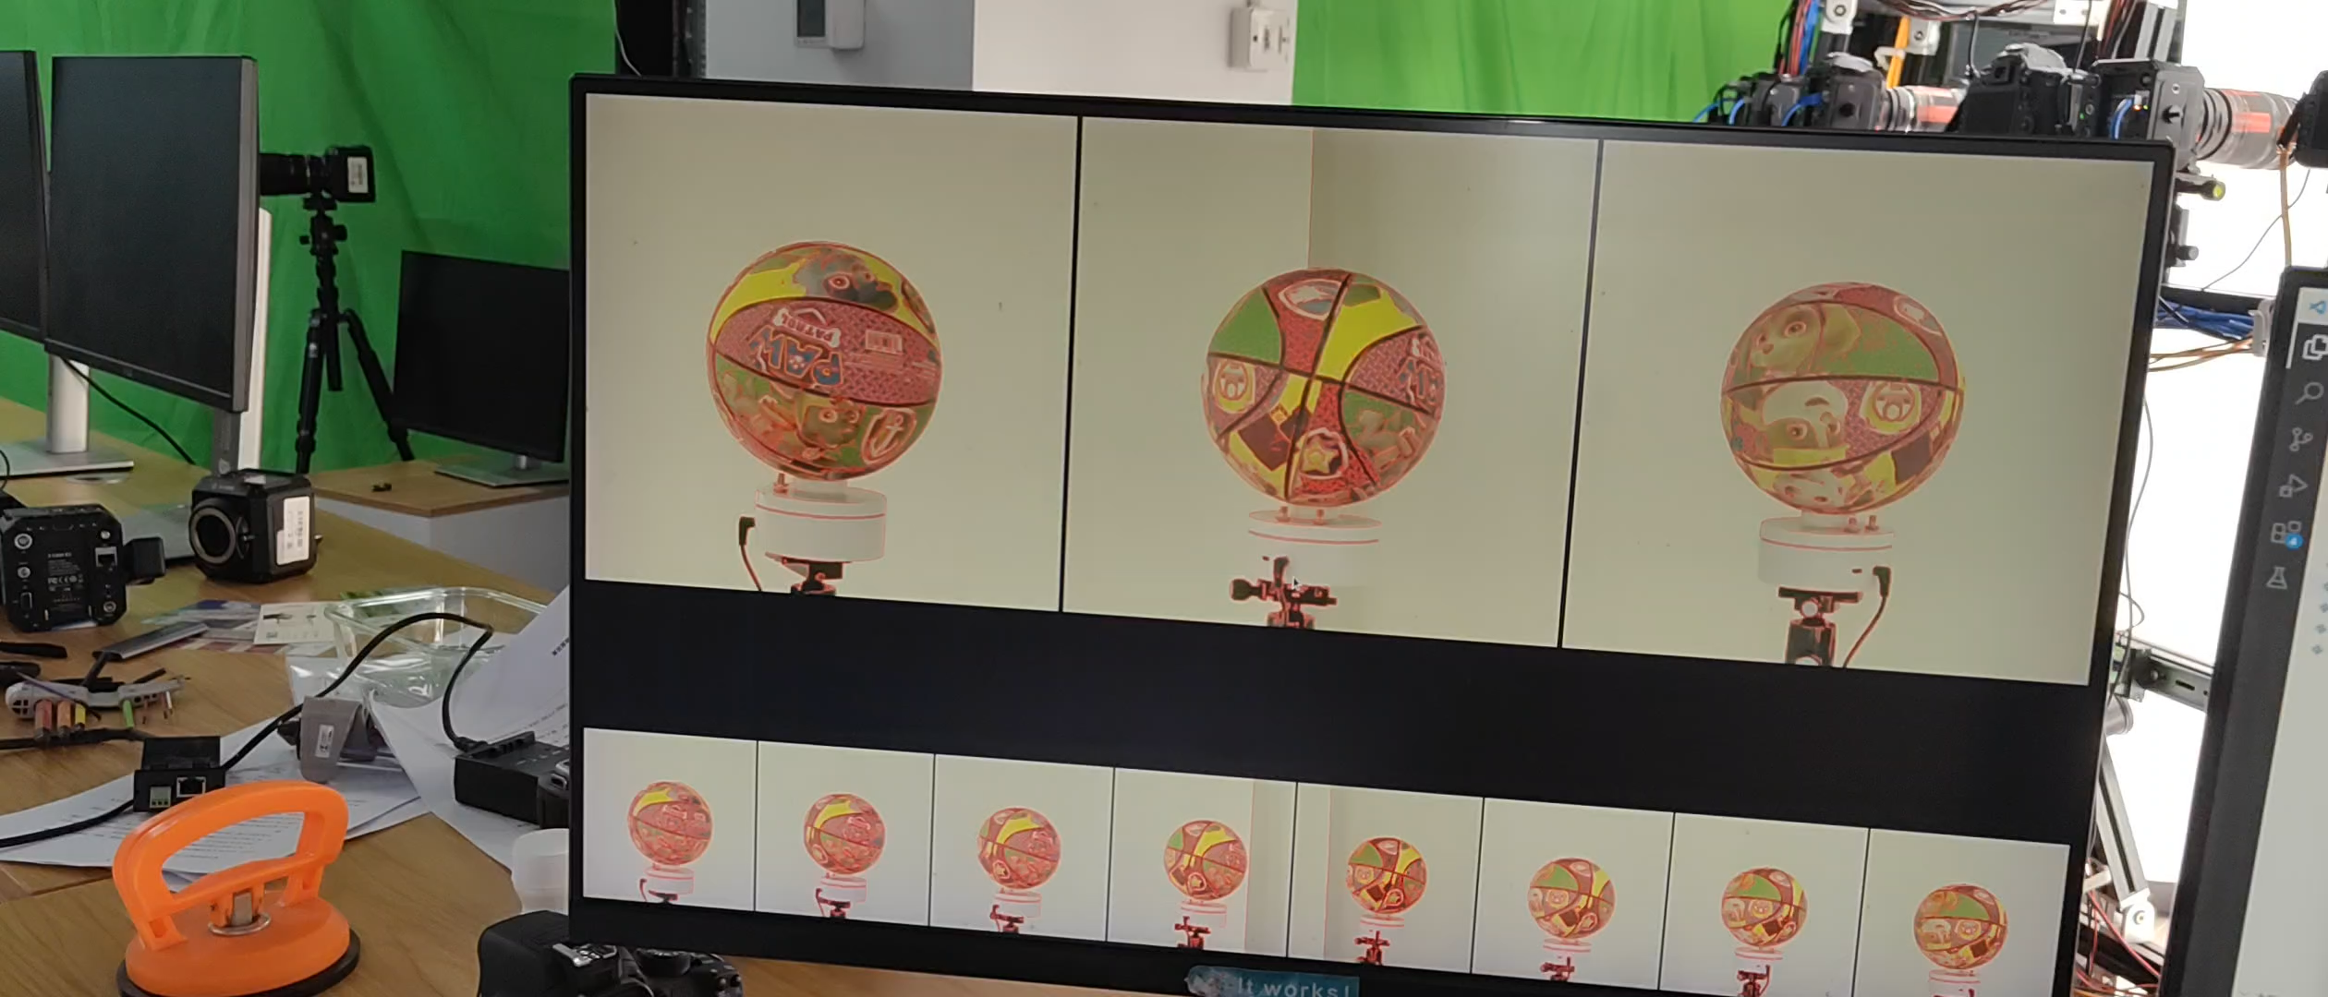
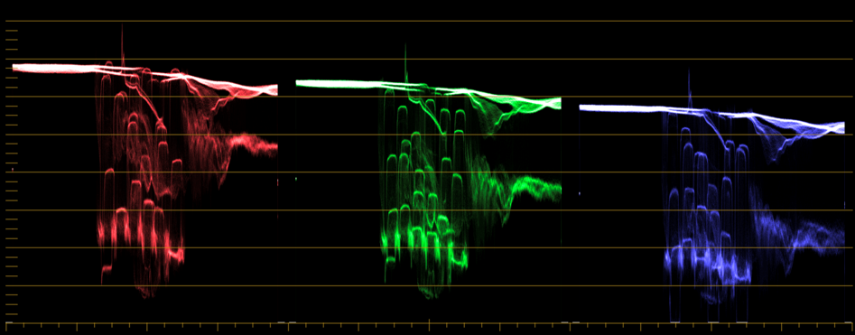
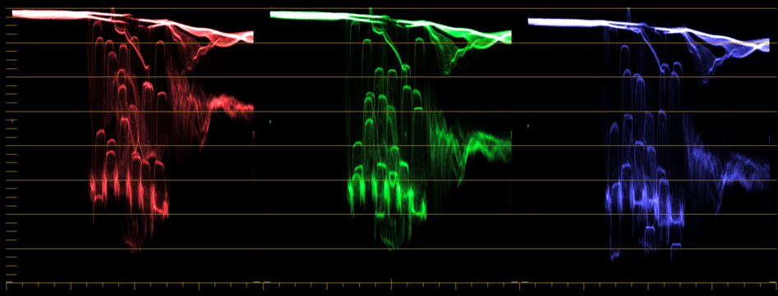
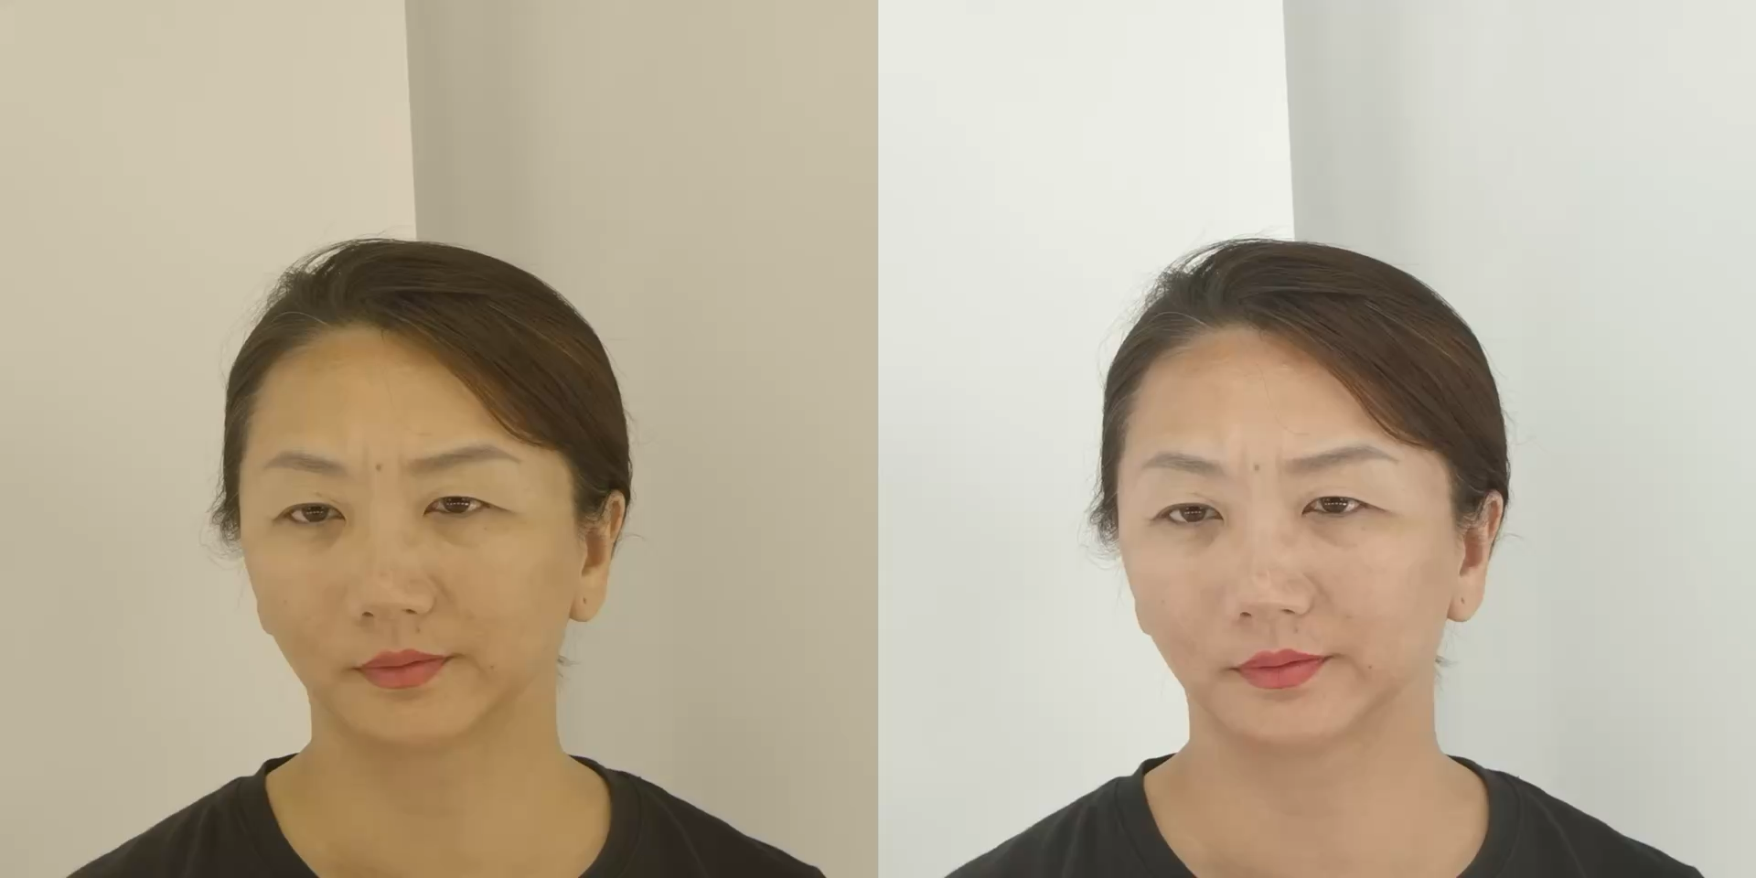
Instruction of EmoTalk3D Dataset
Data Calibration & Monitoring System
Extrinsic calibration: uniformly rotating colored balloon as source, optimized SfM pipeline
Color calibration: X-Rite ColorChecker-based calibration, black/white level correction
Multi-view monitor system: Three main views (A, F, K) and 8 other views, peak focus, position correlation
Content division: DMTF checkpoint caption & automatic division
Multi-view monitor system & Extrinsic calibration
Color calibration

Slide 8
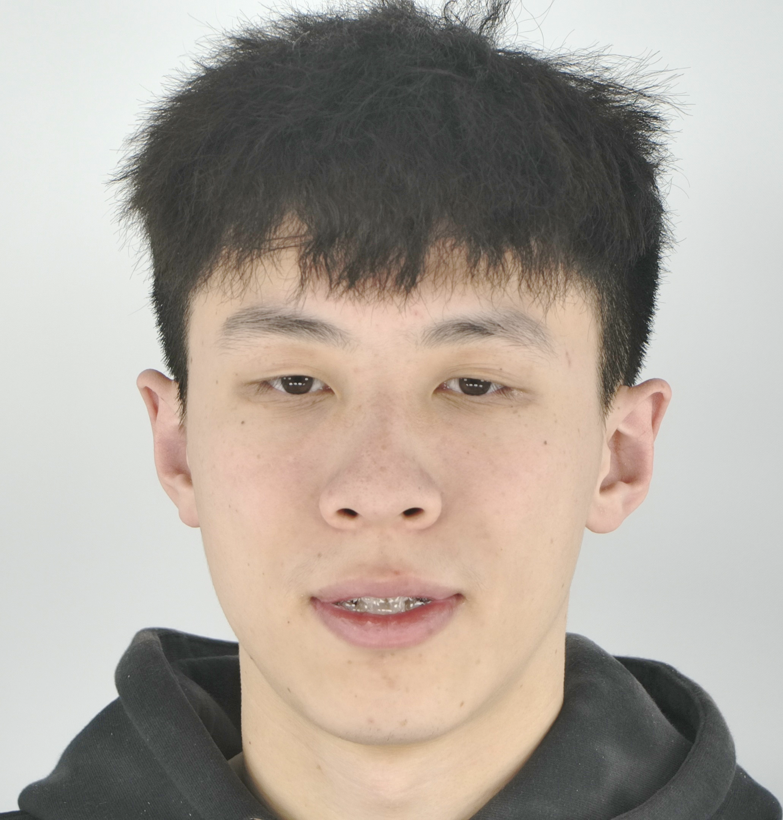
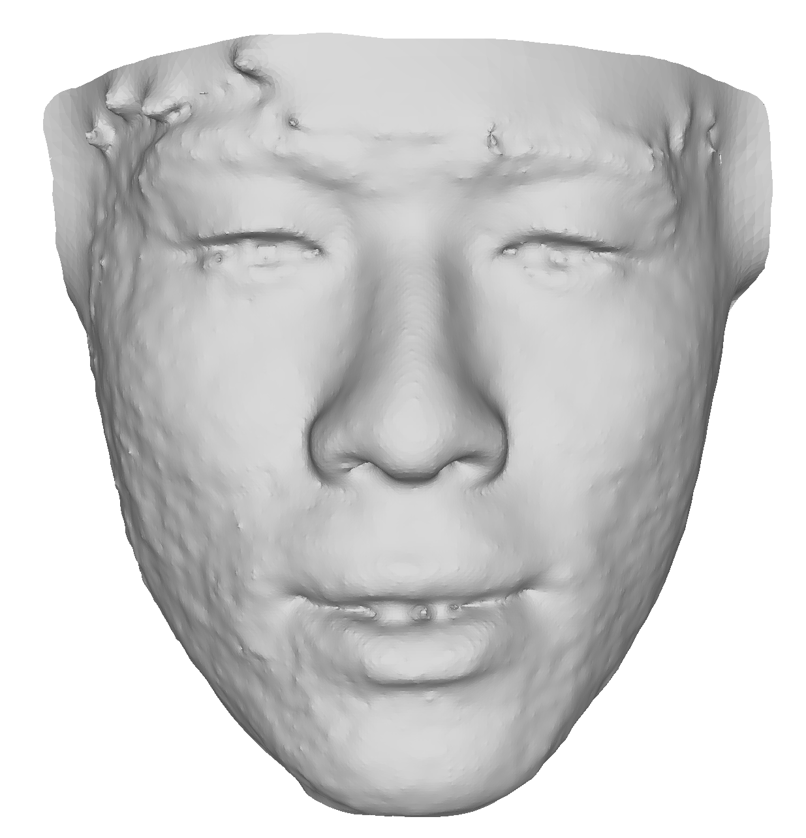
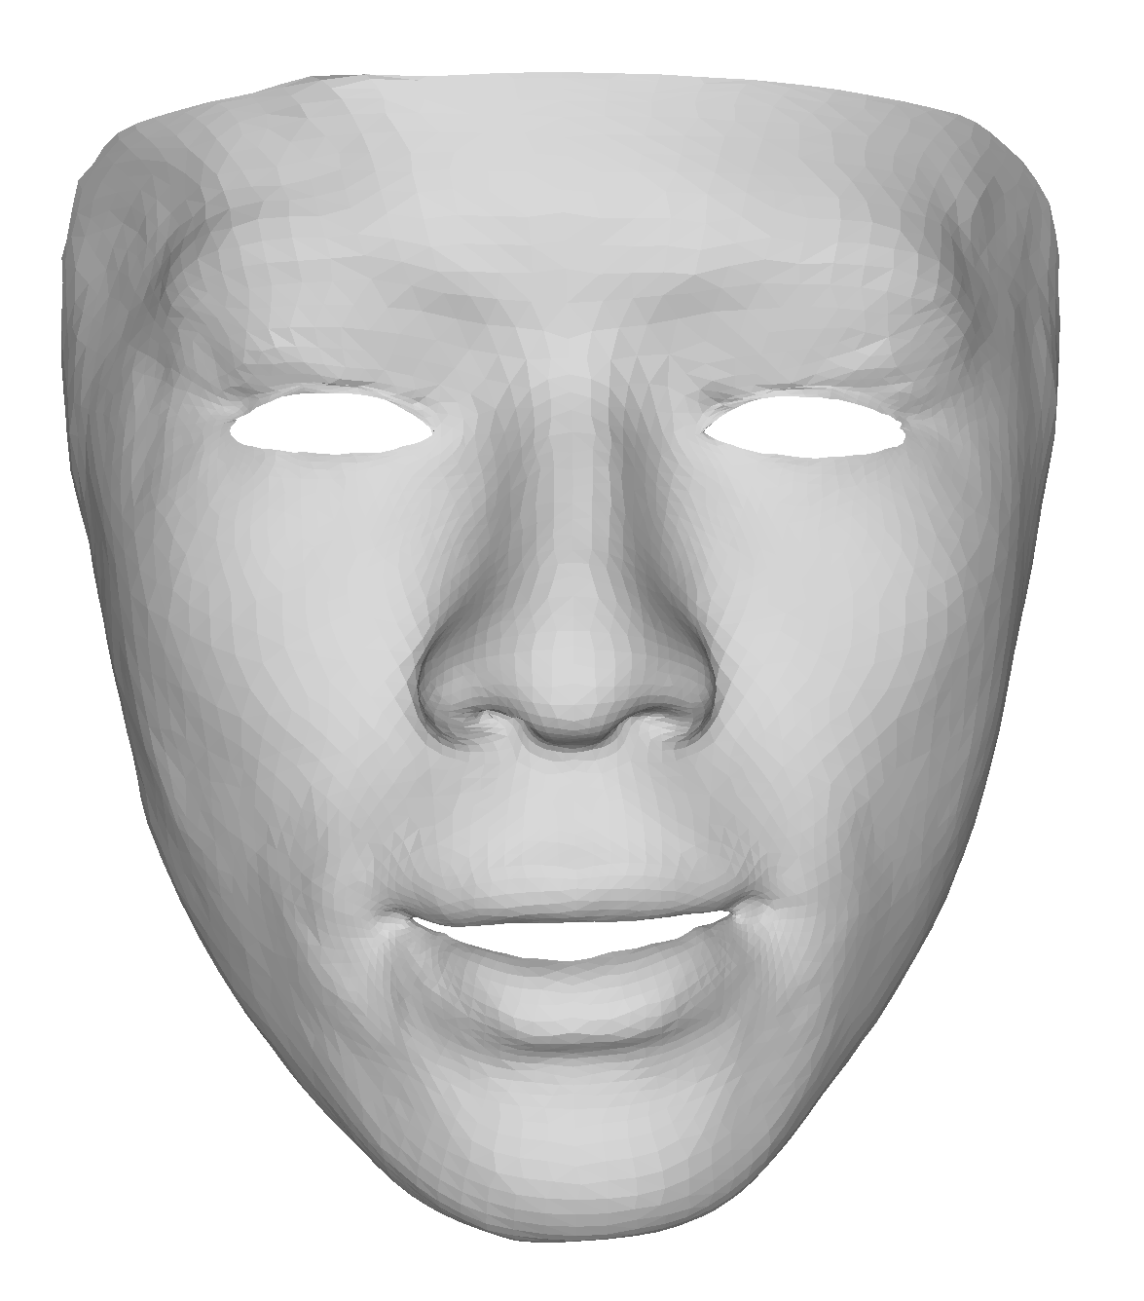
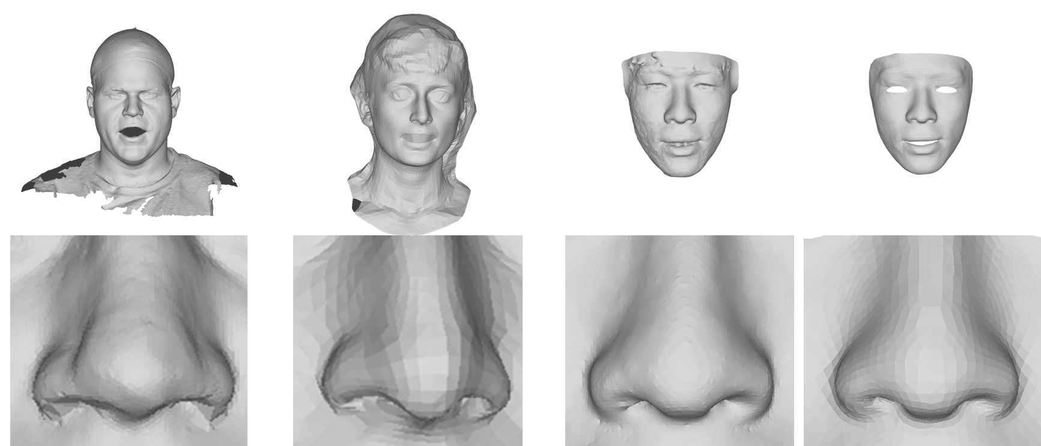
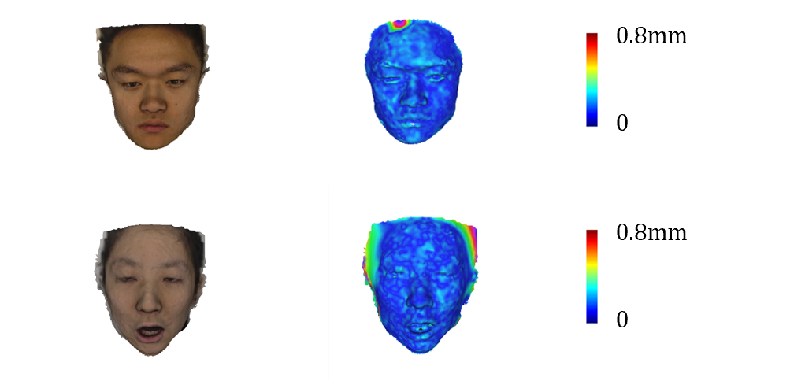
Instruction of EmoTalk3D Dataset
Reconstruction & Registration Pipeline
Vis-MVSNet for reconstruction, NICP for registration, HIGHER mesh quality
Reconstruction & Registration Pipeline
System calib
Ext. & Int. calib
Coord align
Correspond
Video
Recon
Reg
3D recon
Depth recon
Semantic seg
Map seg
Depth Fusion
3D reg
Keypoint extract
Coarse reg
NICP
Blendshape
Mesh Quality Comparison
Mesh Error Analysis
Overall
Nose
VOCA
Multi-Face
Ours(Recon)
Ours(Reg)

Slide 9
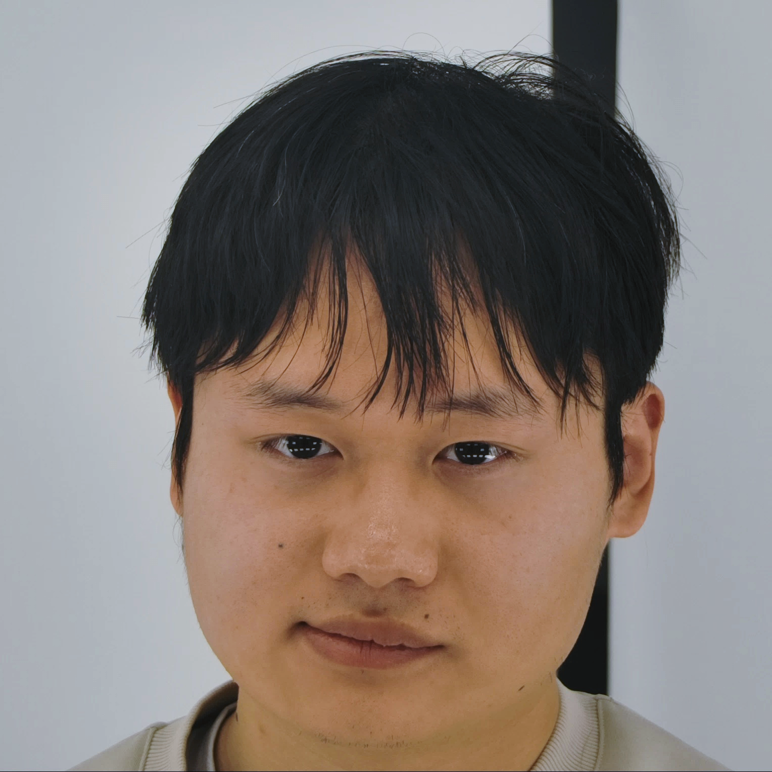
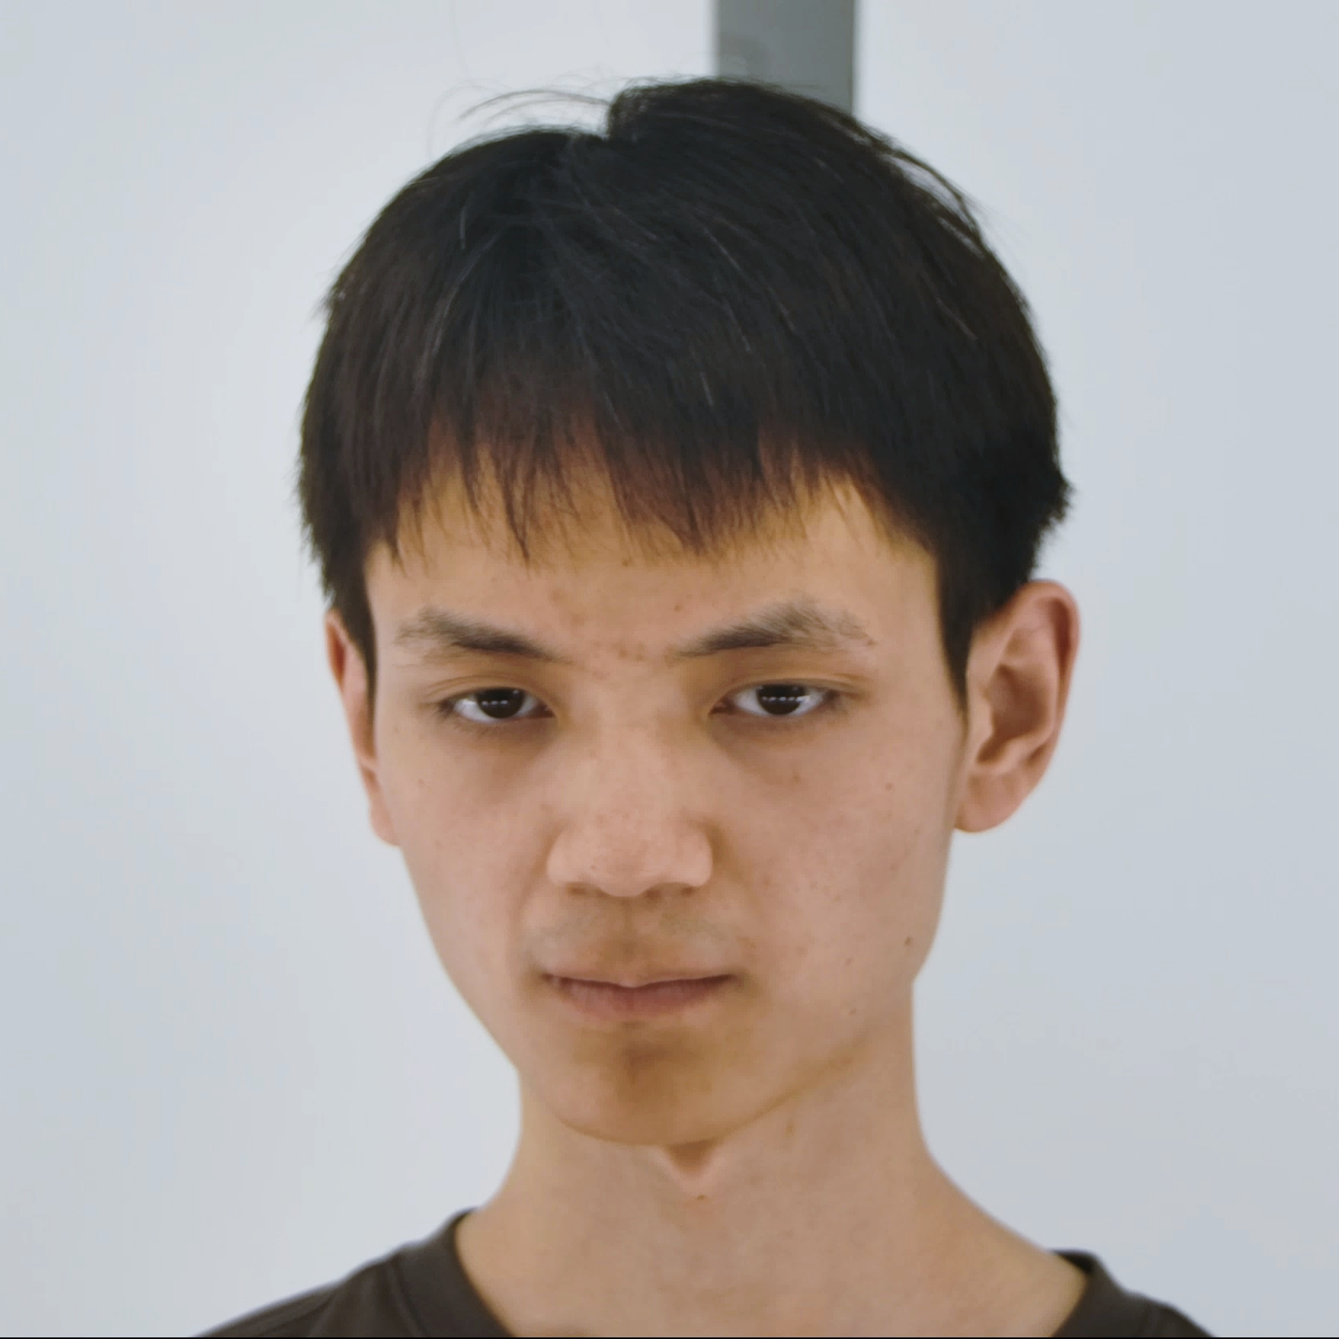
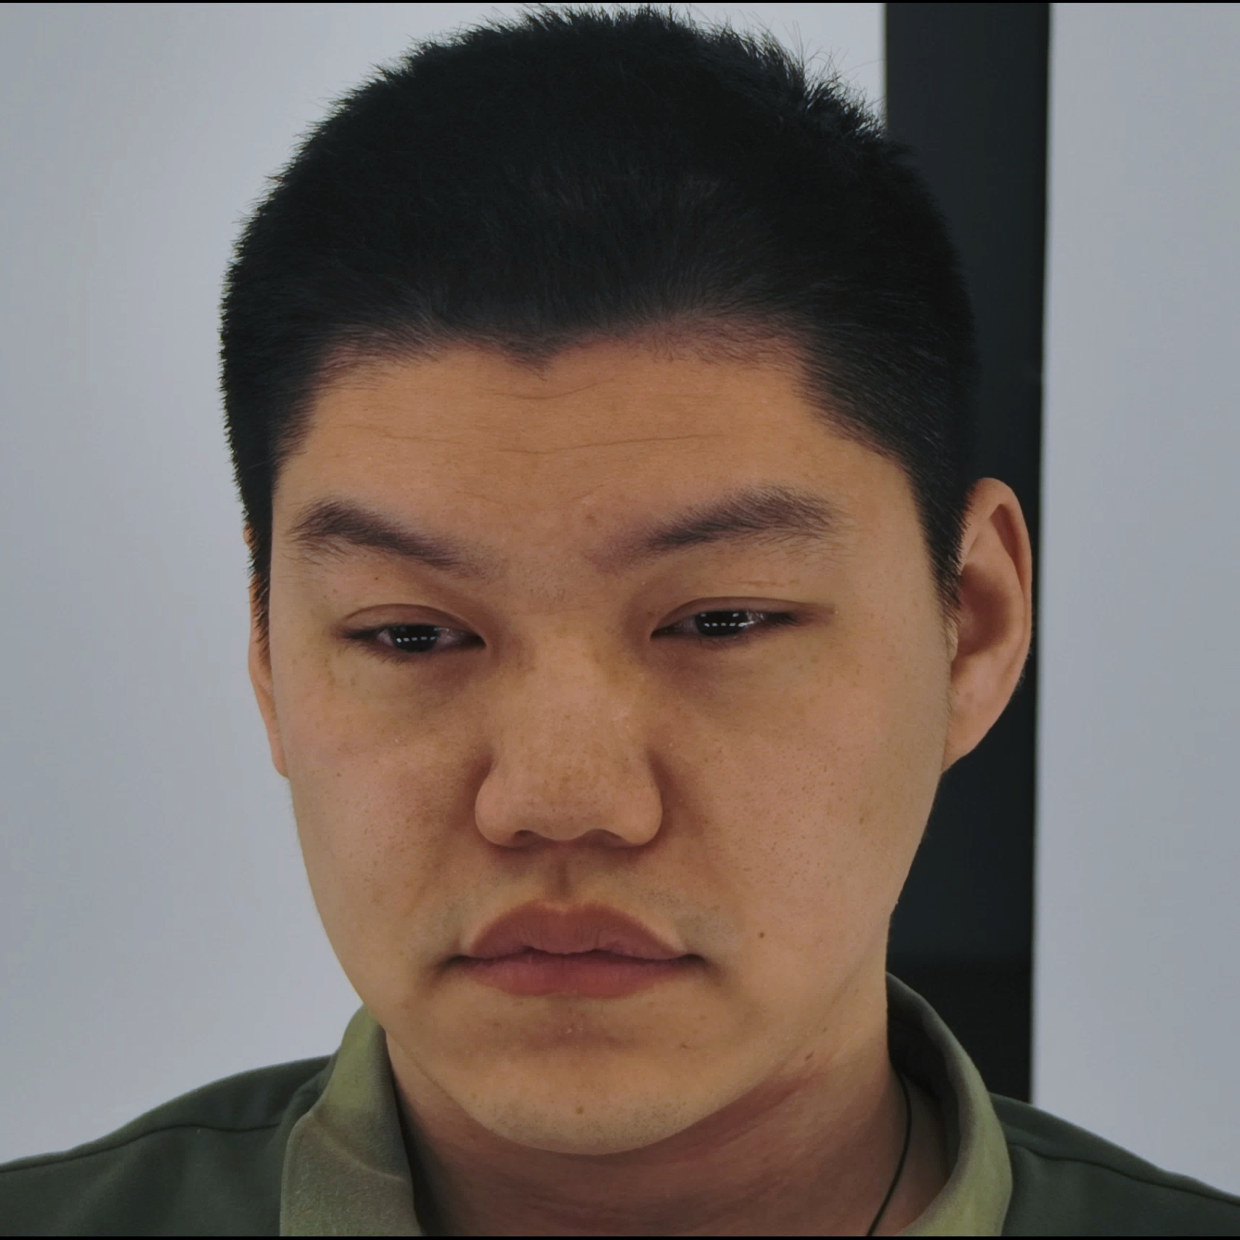

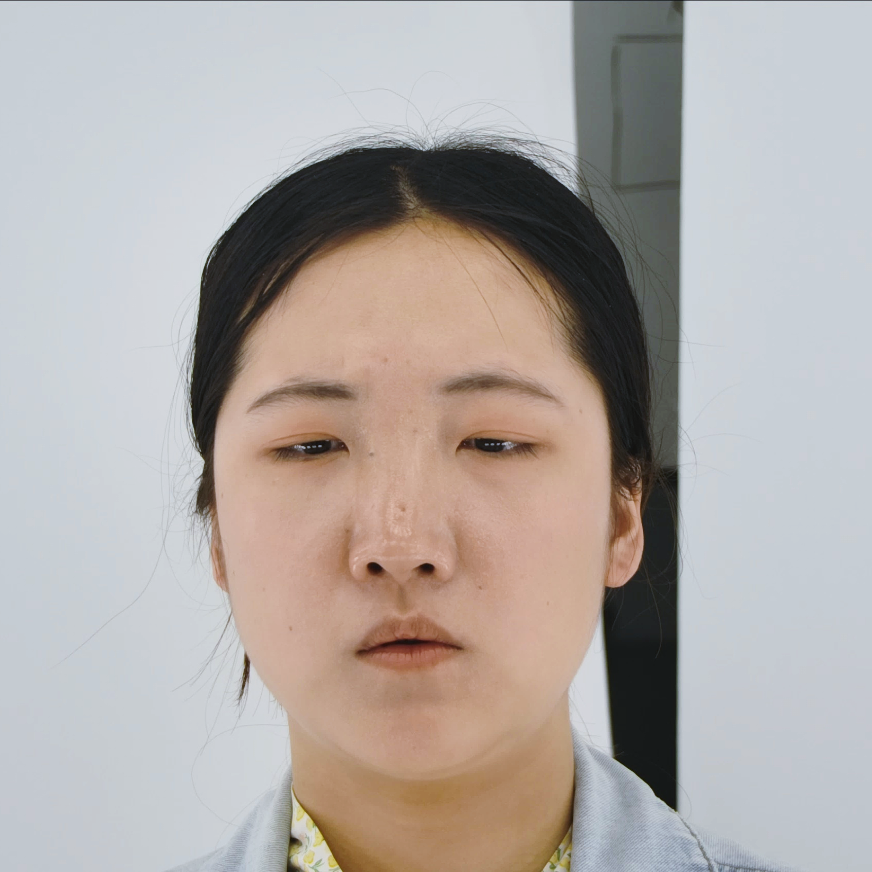

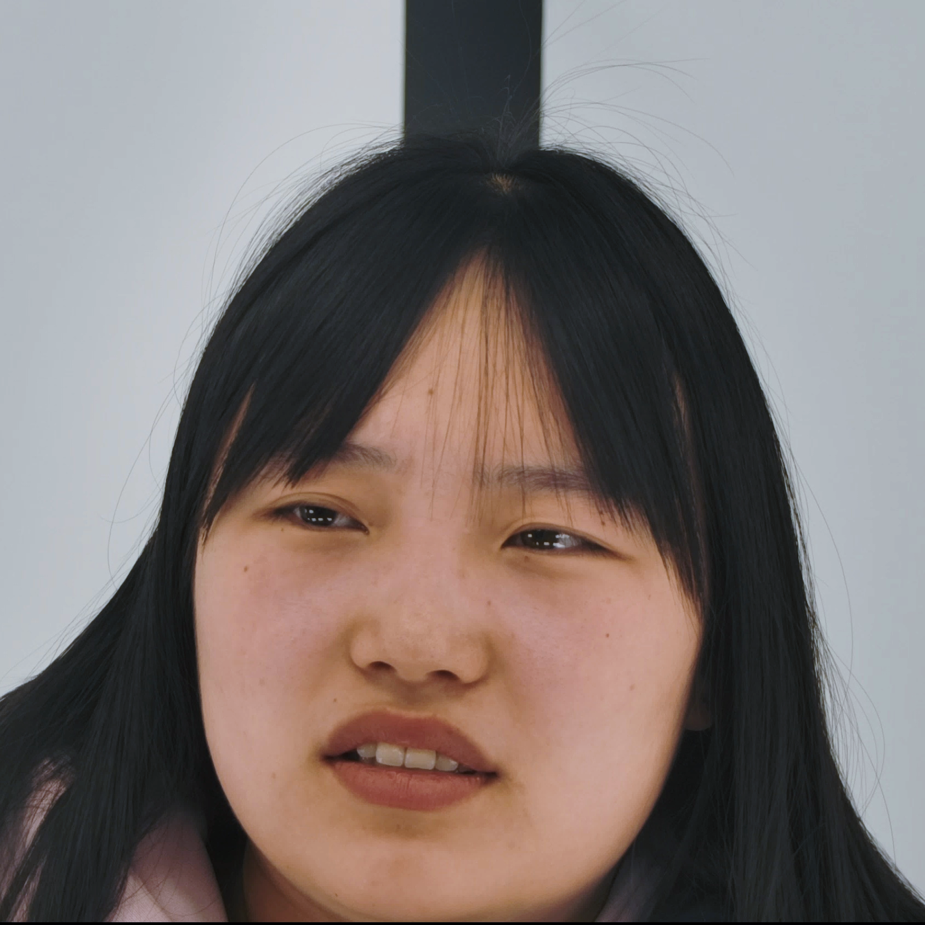
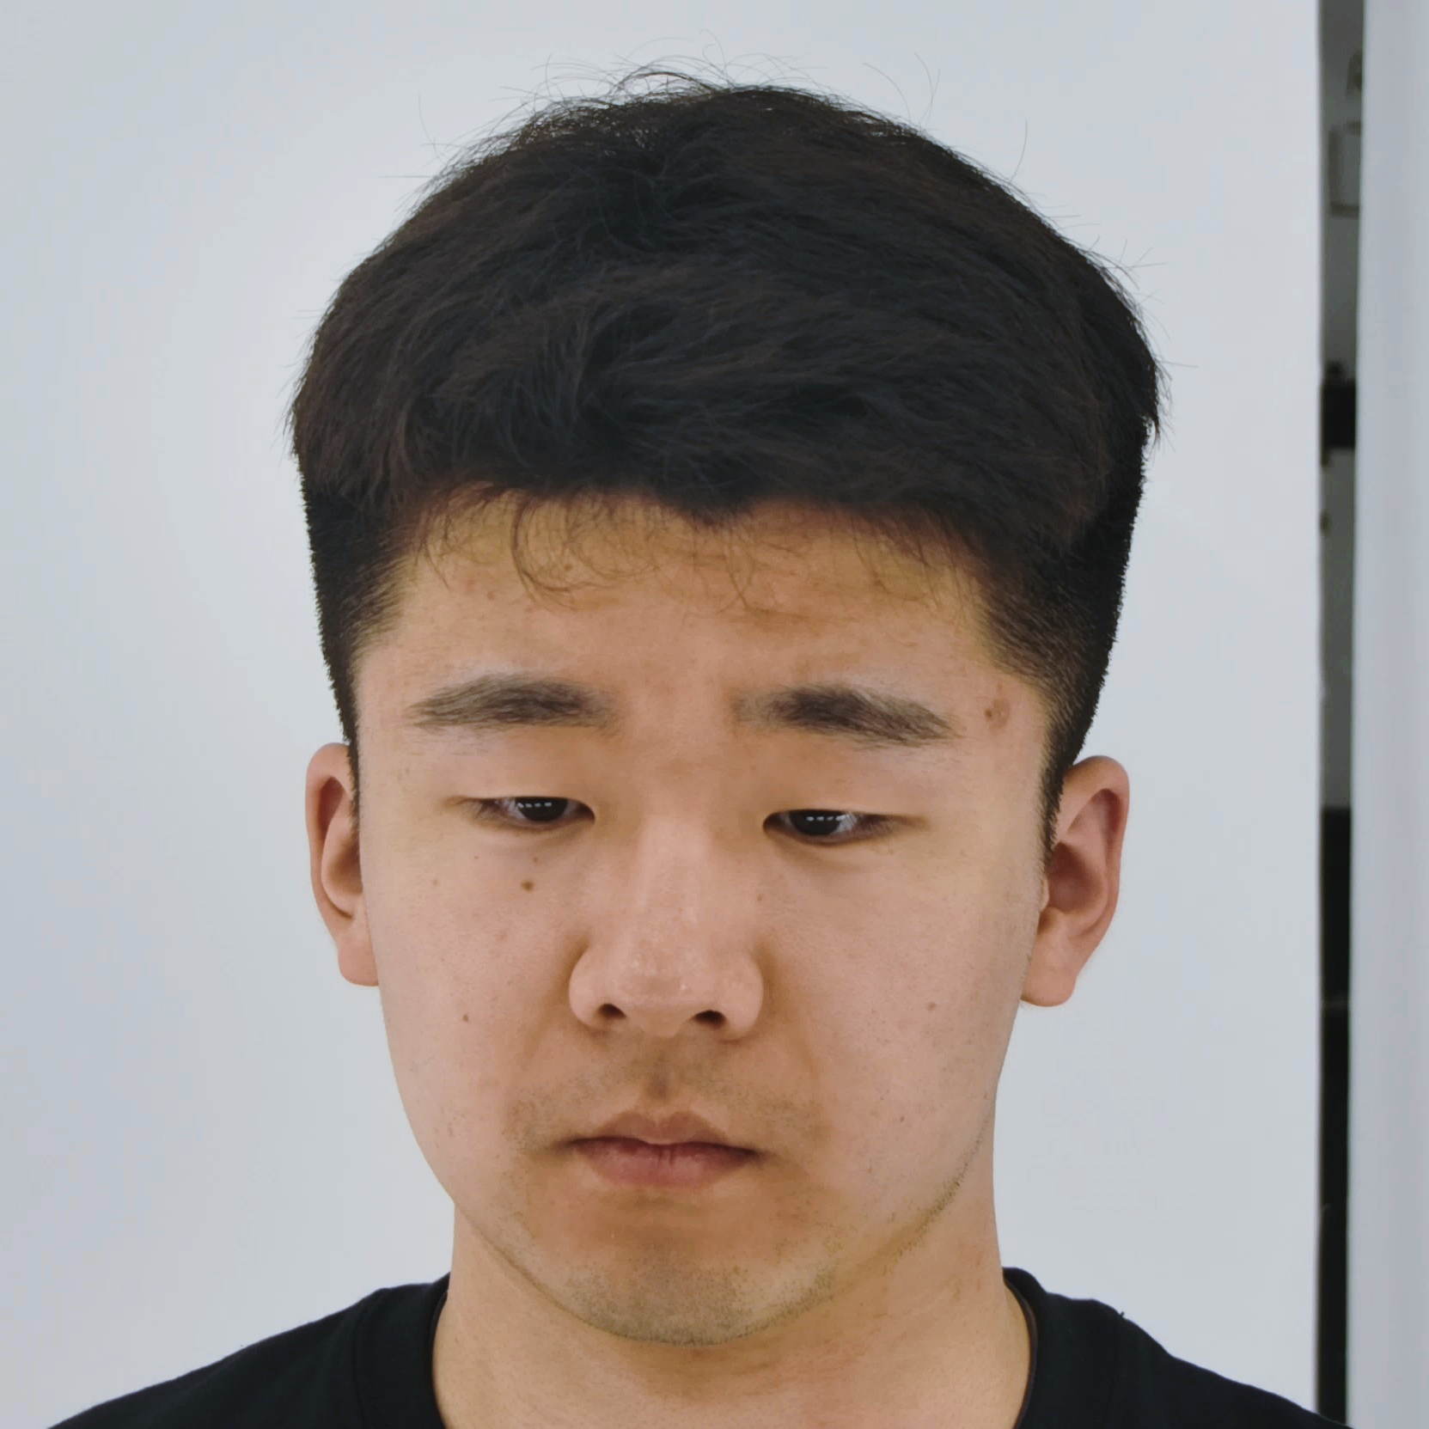
Instruction of EmoTalk3D Dataset
Phase I (30 Identies)

Slide 10
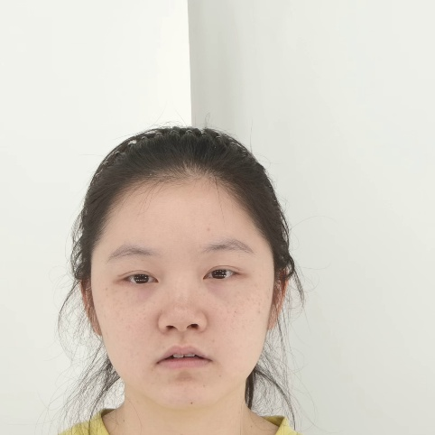

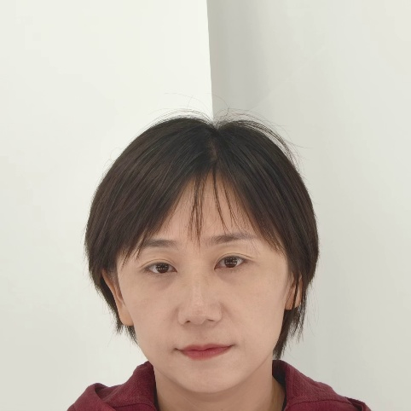



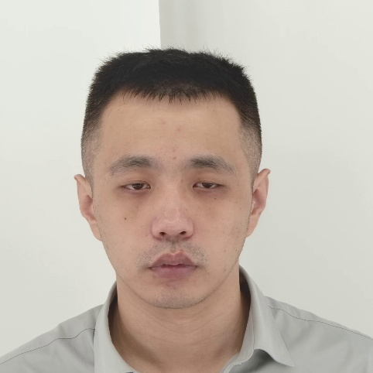

Instruction of EmoTalk3D Dataset
Phase II (70 Identies)

Slide 11
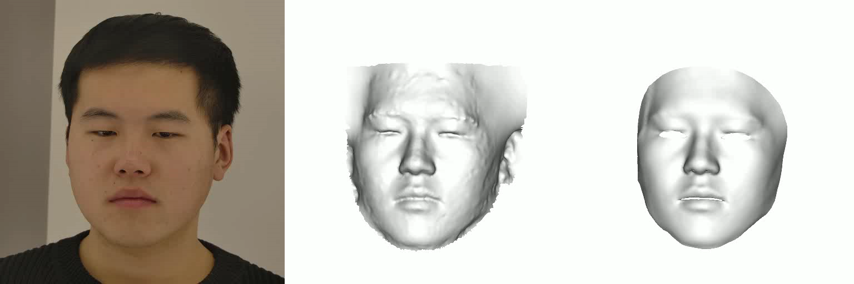
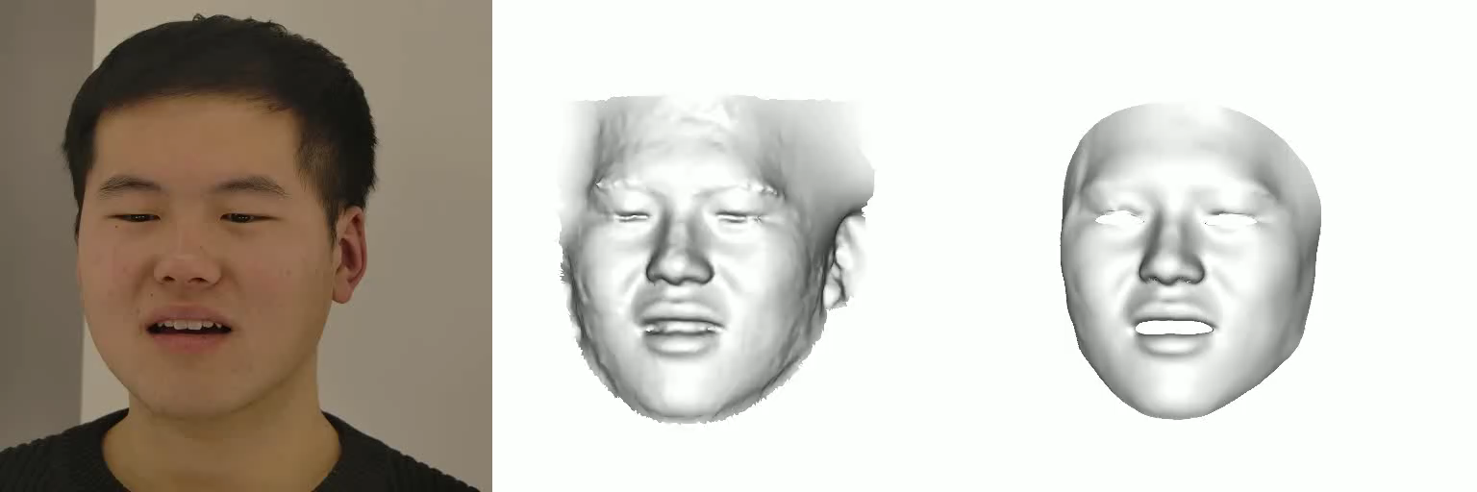
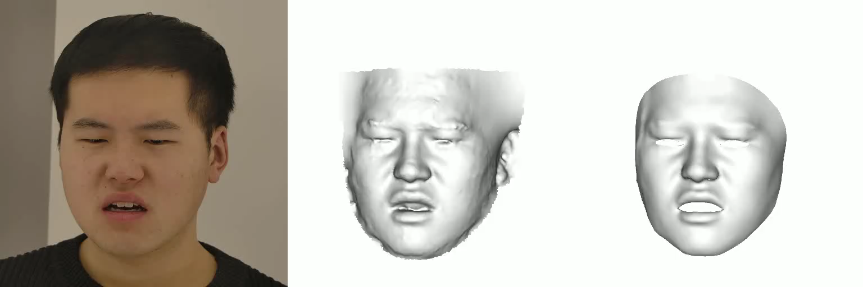
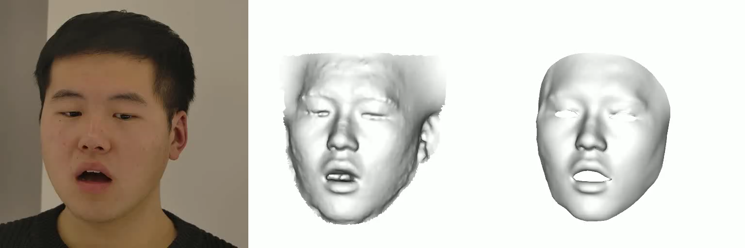
Instruction of EmoTalk3D Dataset
Multi-view Video, reconstruction & registeration
Neutral
Happy
Angry
Surprised

Slide 12
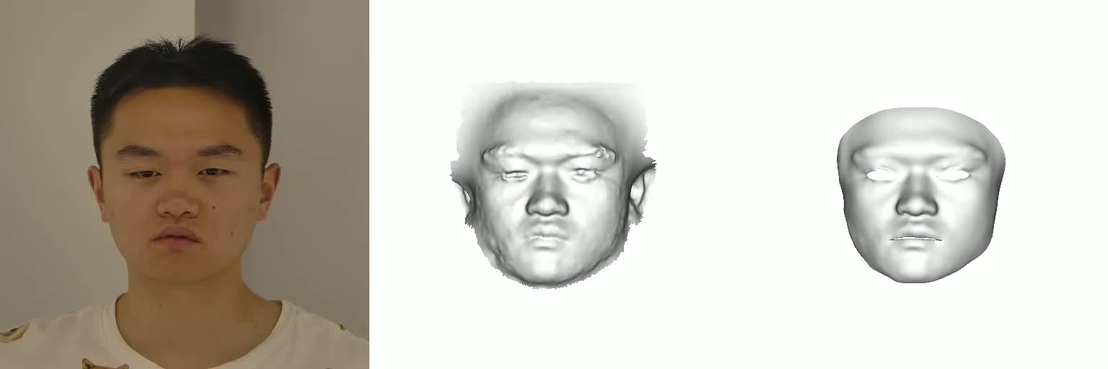
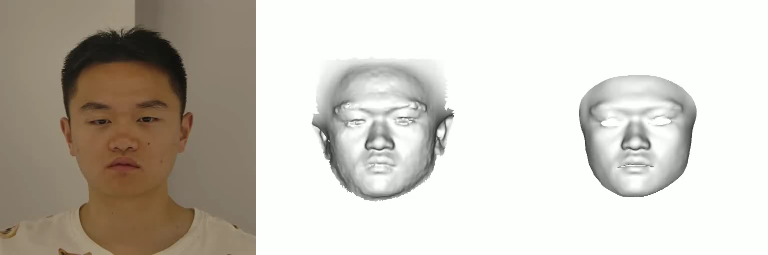













Instruction of EmoTalk3D Dataset
Multi-view Video, reconstruction & registeration
Upper: weak; Lower: strong
Neutral
Angry
Contempt
Disgusted
Fear
Happy
Sad
Surprised

